Slide 1
Photochemistry of Atmospheric Species
Photolysis Reactions
Molecular Spectra and Quantum Yields
Solar Radiation
Fundamentals of Radiative Transfer
Aerosols
Clouds
Radiative Forcing of Climate
Biological Effects of UV Radiation
Sasha Madronich
National Center for Atmospheric Research
Boulder Colorado USA
sasha@ucar.edu
Boulder, 8 February 2011

Slide 2
Energetics of Oxygen in the Atmosphere
ΔH_{f} (298K)
kcal mol⁻¹
Excited atoms O*(¹D) 104.9
Ground state atoms O (³P) 59.6
Ozone O₃ 34.1
Normal molecules O₂ 0
Increasing
stability

Slide 3
Atmospheric Oxygen Thermodynamic vs. Actual
O₃
O
O*

Slide 4
Photochemistry
Thermodynamics alone cannot explain atmospheric amounts of O₃, O, O*
Need
energy input, e.g.
O₂ + hν → O + O (λ < 240 nm)
chemical reactions, e.g.
O + O₂ (+ M) → O₃ (+ M)
= Photochemistry

Slide 5
Some Important Photolysis Reactions
O₂ + hν (λ < 240 nm) → O + O source of O₃ in stratosphere
O₃ + hν (λ < 340 nm) → O₂ + O(¹D) source of OH in troposphere
NO₂ + hν (λ < 420 nm) → NO + O(³P) source of O₃ in troposphere
CH₂O + hν (λ < 330 nm) → H + HCO source of HOx, everywhere
H₂O₂ + hν (λ < 360 nm) → OH + OH source of OH in remote atm.
HONO + hν (λ < 400 nm) → OH + NO source of radicals in urban atm.

Slide 6
Quantifying Photolysis Processes
Photolysis reaction: AB + hν → A + B
Photolysis rates:
Photolysis frequency (s⁻¹) J = ∫_{λ} F(λ) σ(λ) φ(λ) dλ
(other names: photo-dissociation rate coefficient, J-value)

Slide 7
CALCULATION OF PHOTOLYSIS COEFFICIENTS
J (s⁻¹) = ∫_{λ} F(λ) σ(λ) φ(λ) dλ
F(λ) = spectral actinic flux, quanta cm⁻² s⁻¹ nm⁻¹
∝ probability of photon near molecule.
σ(λ) = absorption cross section, cm² molec⁻¹
∝ probability that photon is absorbed.
φ(λ) = photodissociation quantum yield, molec quanta⁻¹
∝ probability that absorbed photon causes dissociation.

Slide 8
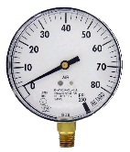
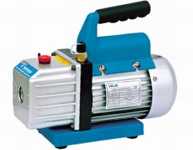
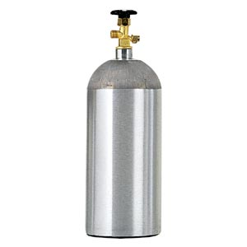
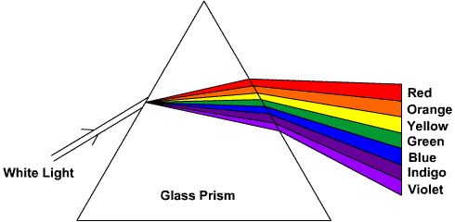
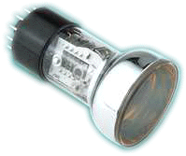
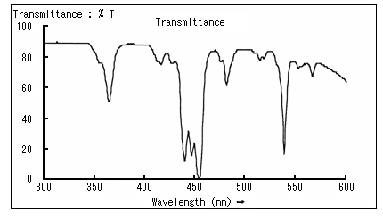
Measurement of Absorption Cross Section σ(λ)
Pressure
gage
Gas
supply
Pump for
clean out
Gas
in
Prism
Light
detector
Absorption cell
Lamp
L
Transmittance = I / I_{o} = exp(-σ n L)
σ = -1/(nL) ln( I/I_{o} )
Easy: measure pressure (n = P/RT), and relative change in light: I/I_{o}

Slide 9
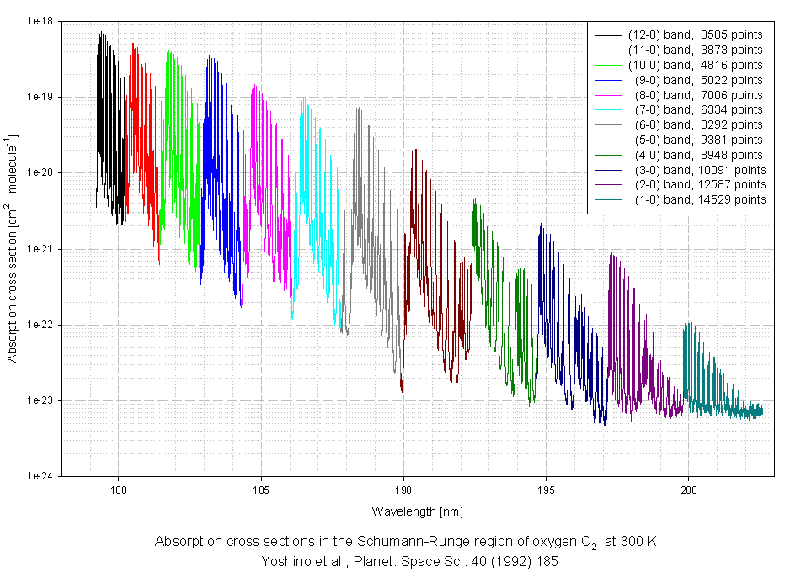
O₂ Absorption Cross Section

Slide 10
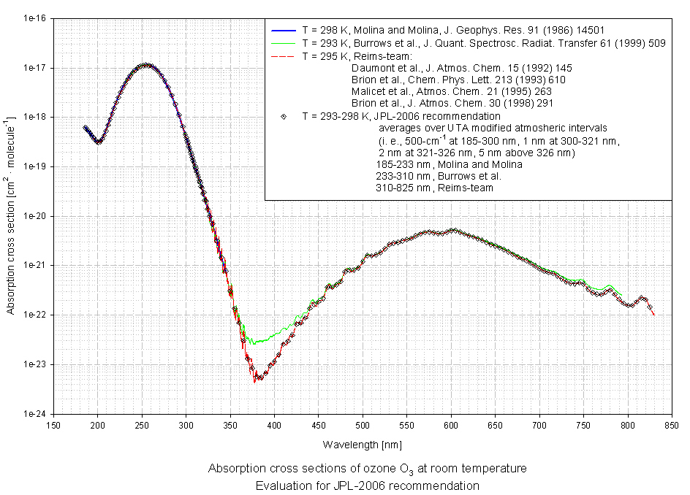
O₃ Absorption Cross Section

Slide 11
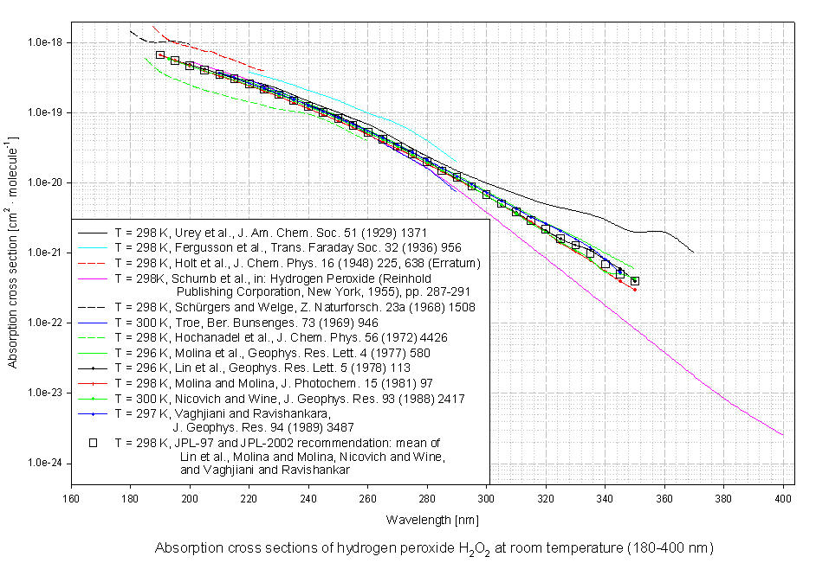
H₂O₂ Absorption Cross Section

Slide 12
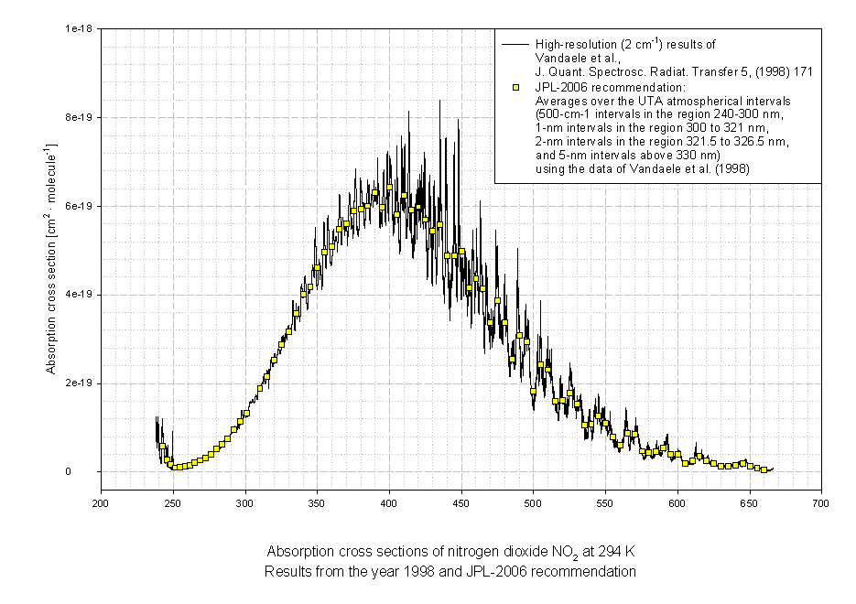
NO₂ Absorption Cross Section

Slide 13
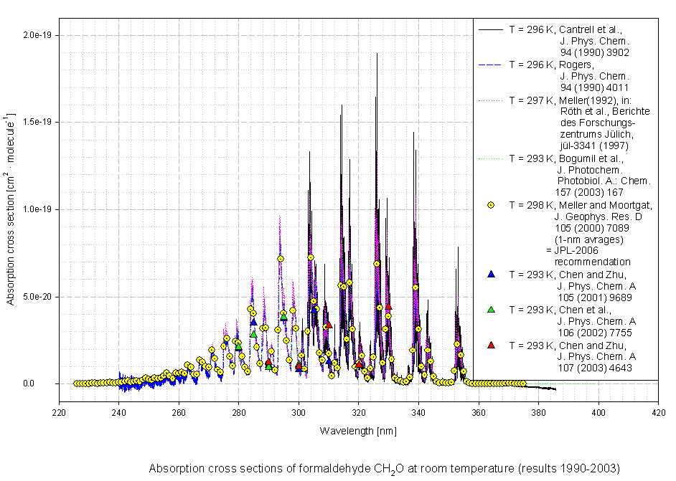
CH₂O Absorption Cross Section

Slide 14
Measurement of Quantum Yields φ(λ)
Pressure
gage
Gas
supply
Pump for
clean out
Gas
in
Prism
Light
detector
Absorption cell
Lamp
L
Transmittance = I / I_{o} = exp(-σ n L)
Quantum Yield = number of breaks per photon absorbed
φ = Δn / ΔI
Difficult: must measure absolute change in n (products) and I (photons absorbed)

Slide 15
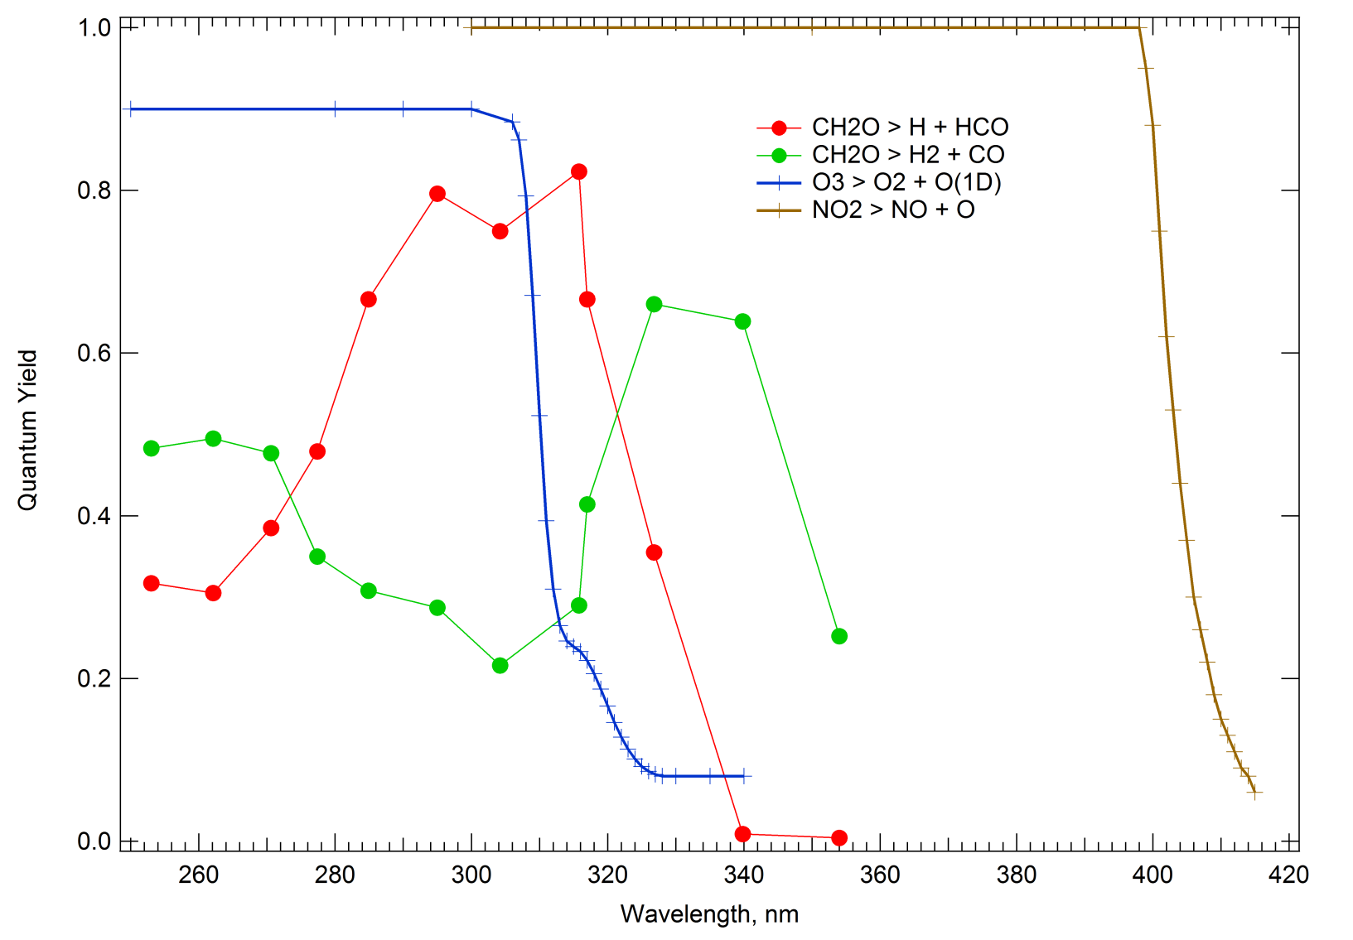
Measured Quantum Yields

Slide 16
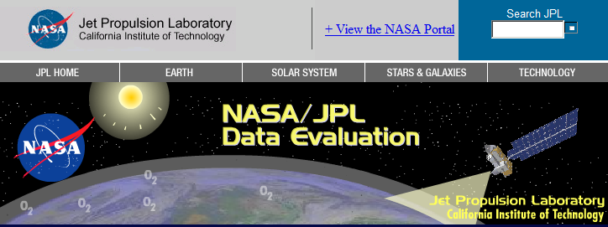
Compilations of Cross Sections & Quantum Yields
http://www.atmosphere.mpg.de/enid/2295
http://jpldataeval.jpl.nasa.gov/

Slide 17
Spectral Range For Tropospheric Photochemistry
surface, overhead sun

Slide 18
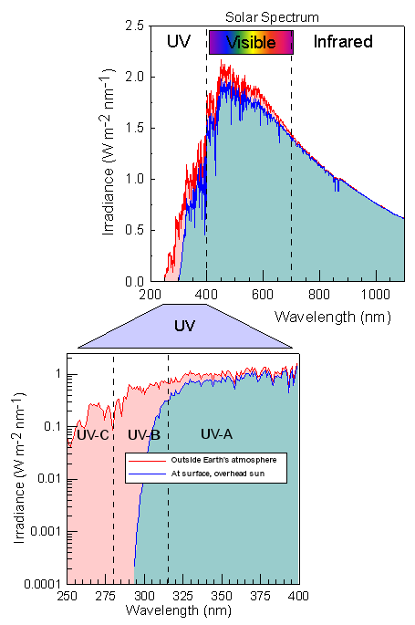
Solar Spectrum
O₂ and O₃ absorb
all UV-C (λ<280 nm)
before it reaches the
troposphere
UNEP, 2002

Slide 19
Typical Vertical Optical Depths, τ
Direct transmission = exp(-τ)
Diffuse transmission can be much larger

Slide 20
DIFFUSE LIGHT - CLEAN SKIES, SEA LEVEL
Irradiance
Actinic flux

Slide 21
RADIATIVE TRANSFER
CONCEPTS

Slide 22
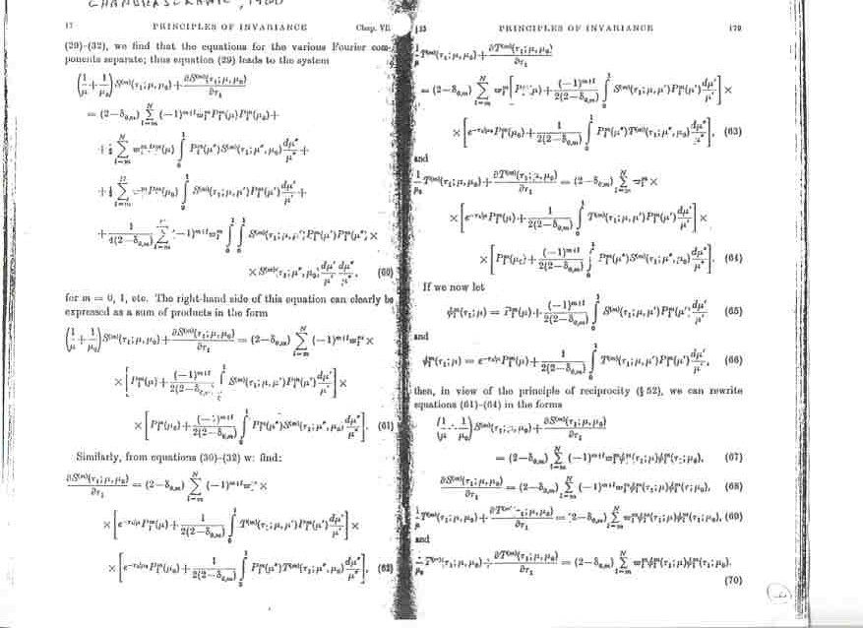
RADIATIVE TRANSFER THEORY …is hard

Slide 23
Spectral Radiance, I
I(λ,θ,φ) = N(hc/λ) / (dt dA dω dλ)
units: J s⁻¹ m⁻² sr⁻¹ nm⁻¹
(old name = spectral Intensity)

Slide 24
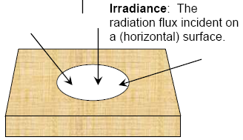
INTEGRALS OVER ANGULAR INCIDENCE
Watts m⁻²
Watts m⁻² or quanta s⁻¹ cm⁻²

Slide 25
Absorption and Scattering
Absorption – inelastic, loss of radiant energy:
Scattering – elastic, radiant energy is conserved, direction changes:

Slide 26
Beer-Lambert Law
Volume of box = V = Area x Thickness = A dz
z
z+dz
Molecules (or particles):
each has cross sectional area σ
total number = N = n V
total area of molecules = σ N = σ n A dz
I(z)
I(z+dz)
Fraction of light lost = fraction of area shaded
by molecules = σ n A dz / A = σ n dz
Fraction of light surviving box:
I(z+dz)/I(z) = 1 - σ n dz
or [I(z+dz) - I(z)] / dz = - σ n I(z)
or (lim dz → 0)
(differential form) dI/dz = - σ n I
(integral form) I(z₂) = I(z₁) exp [- σ n (z₂-z₁)]

Slide 27
Definition of Optical Depth
Beer-Lambert Law: I(z₂) = I(z₁) exp [- σ n (z₂-z₁)]
Optical depth: τ = σ n (z₂-z₁)
If σ and/or n depend on z, then
In monochromatic radiative transfer,
τ is often used as the spatial coordinate
(instead of z)

Slide 28
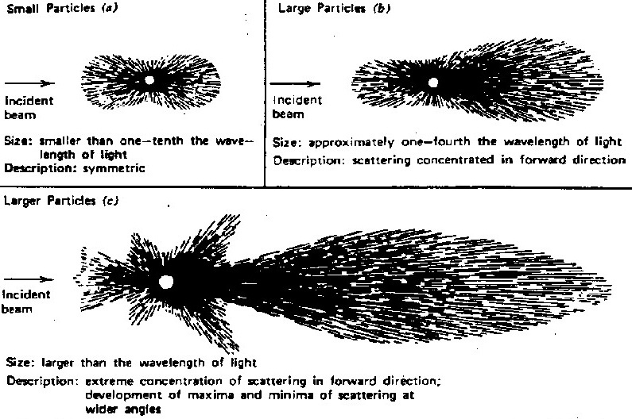
SCATTERING PHASE FUNCTIONS
P(θ, φ; θ’, φ’)

Slide 29
The Radiative Transfer Equation
Propagation derivative
Beer-Lambert
attenuation
Scattering from
direct solar beam
Scattering from diffuse light
(multiple scattering)

Slide 30
NUMERICAL SOLUTIONS TO RADIATIVE TRANSFER EQUATION
Discrete ordinates
n-streams (n = even), angular distribution
exact as n→∞ but speed ∝ 1/n²
Two-stream family
delta-Eddington, many others
very fast but not exact
Monte Carlo
slow, but ideal for 3D problems
Others
matrix operator, Feautrier, adding-doubling, successive orders, etc.

Slide 31
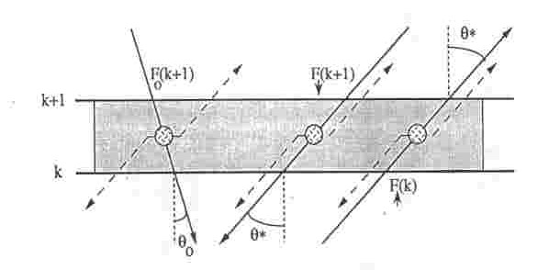
Multiple Atmospheric Layers Each Assumed to be Homogeneous
Must specify three optical properties:
Optical depth, Δτ
Single scattering albedo, ω_{o} = scatt./(scatt.+abs.)
Asymmetry factor, g: forward fraction, f ~ (1+g)/2

Slide 32
For each layer, must specify Δτ, ω_{o}, g:
Vertical optical depth, Δτ(λ, z) = σ(λ, z) n(z) Δz
for molecules: Δτ(λ, z) ~ 0 - 30
Rayleigh scatt. ~ 0.1 - 1.0 ~ λ⁻⁴
O₃ absorption ~ 0 - 30
for aerosols: 0.01 - 5.0
Δτ(λ, z) ~ λ^{-α}
for clouds: 1-1000
α ~ 0
cirrus ~ 1-5
cumulonimbus ~ > 100

Slide 33
For each layer, must specify Δτ, ω_{o}, g:
2. Single scattering albedo, ω_{o}(λ, z) = scatt./(scatt.+abs.)
range 0 - 1
limits: pure scattering = 1.0
pure absorption = 0.0
for molecules, strongly λ-dependent, depending on
absorber amount, esp. O₃
for aerosols:
sulfate ~ 0.99
soot, organics ~ 0.8 or less,
not well known but probably higher
at shorter λ, esp. in UV
for clouds: typically 0.9999 or larger (vis and UV)

Slide 34
For each layer, must specify Δτ, ω_{o}, g:
3. Asymmetry factor, g(λ, z) = first moment of phase function
range -1 to + 1
pure back-scattering = -1
isotropic or Rayleigh = 0
pure forward scattering = +1
strongly dependent on particle size
for aerosols:, typically 0.5-0.7
for clouds, typically 0.7-0.9
Mie theory for spherical particles: can compute Δτ, ω_{o}, g
from knowledge of λ, particle radius and complex index of refraction

Slide 35
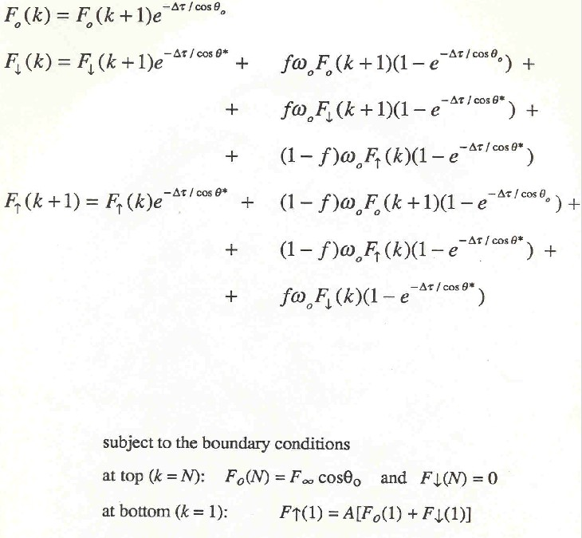
SIMPLE
2-STREAM
METHOD:
3 Equations
for each layer

Slide 36
AEROSOLS

Slide 37
Many different types of aerosols
Size distributions
Composition (size-dependent)
Need to determine aerosol optical properties:
τ(λ) = optical depth
ω_{o} = single scattering albedo
P(Θ) = phase function or g = asymmetry factor

Slide 38
Mie Scattering Theory
For spherical particles, given:
Complex index of refraction: n = m + ik
Size parameter: α = 2πr / λ
Can compute:
Extinction efficiency Q_{e}(α, n) x πr²
Scattering efficiency Q_{s}(α, n) x πr²
Phase function P(Θ, α, n)
or asymmetry factor g(α, n)

Slide 39
Extinction Efficiency, Q_{ext}
n = 1.55 + 0.01i

Slide 40
Phase function or Asymmetry factor, g

Slide 41
Single Scattering Albedo = Q_{scatt}/Q_{ext}

Slide 42
Aerosol size distributions

Slide 43
Optical properties of aerosol ensembles
Total extinction coefficient =
Total scattering coefficient =
Average single scattering albedo =
Average asymmetry factor =

Slide 44
UV Actinic Flux Reduction → Slower Photochemistry
Mexico City
Madronich, Shetter, Halls, Lefer, AGU’07

Slide 45
Aerosol Effects NO₂ Photolysis Frequency 19N, April, noon, AOD = 1 at 380 nm
Castro et al. 2001

Slide 46
CLOUDS

Slide 47
UNIFORM CLOUD LAYER
Above cloud: - high radiation because of reflection
Below cloud: - lower radiation because of attenuation by cloud
Inside cloud: - complicated behavior
Top half: very high values (for high sun)
Bottom half: lower values

Slide 48
EFFECT OF UNIFORM CLOUDS ON ACTINIC FLUX

Slide 49
INSIDE CLOUDS: Photon Path Enhancements
Cumulonimbus, od=400
Mayer et al., 1998

Slide 50
Broken Clouds

Slide 51
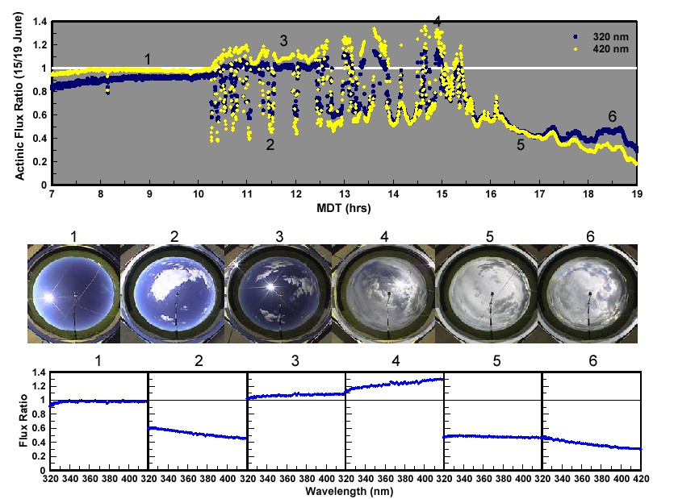
SPECTRAL EFFECTS OF PARTIAL CLOUD COVER
Crafword et al., 2003

Slide 52
PARTIAL CLOUD COVER Biomodal distributions
Crawford et al., 2003

Slide 53
Independent Pixel Approximation
Cloud free:
S_{o} = direct sun
D_{o} = diffuse light from sky
G_{o} = total = S_{o} + D_{o}
Completely covered by clouds:
S₁ = direct sun (probably very small)
D₁ = diffuse light from base of cloud
G₁ = total = S₁ + D₁
Mix: Clouds cover a fraction c of the sky
If sun is not blocked: G_{NB} = S_{o} + cD₁ + (1-c)D_{o}
If sun is blocked: G_{B} = S₁ + cD₁ + (1-c)D_{o}

Slide 54
Photochemistry Inside Liquid Particles
aerosol
clouds
Mayer and Madronich, 2004

Slide 55
Radiative Forcing of Climate

Slide 56
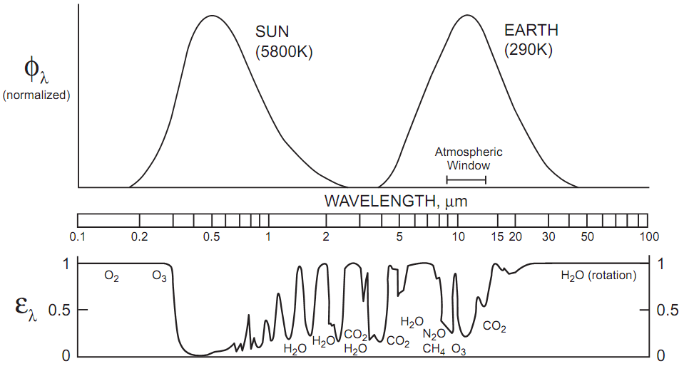
Shortwave and Longwave Radiation

Slide 57
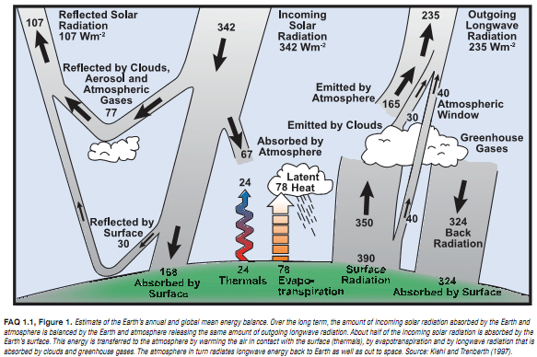
Energy Balance

Slide 58
Infrared Absorbers

Slide 59
Very Structured Spectra

Slide 60
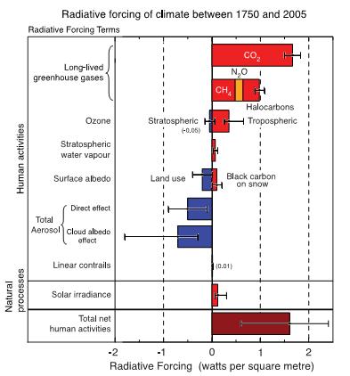
Radiative Forcing
Incoming solar ~340 W m⁻²
1827 – Fourier recognizes atmospheric heat trapping
1860 – Tyndall measures infrared spectra
1896 – Arrhenius estimates doubling of CO₂
would increase global temperatures by 5-6 ºC
Changes since 1750:
long-lived gases ~ 3 W m⁻²
ozone ~ 0.4 W m⁻²
aerosols and clouds ~ -1 W m⁻²
IPCC, 2007

Slide 61
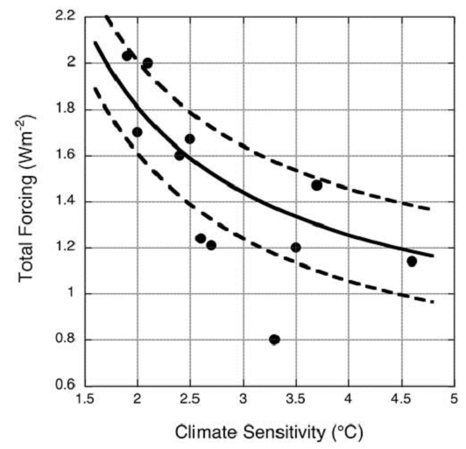
Some Climate Model Problems
11 models compared
All predict 20th century climate
well, but for different reasons
Trade off between
- aerosol forcing
- climate sensitivity
Climate sensitivity = ΔT for doubling of CO₂
Kiehl, 2007

Slide 62
Biological Effects of Ultraviolet Radiation

Slide 63
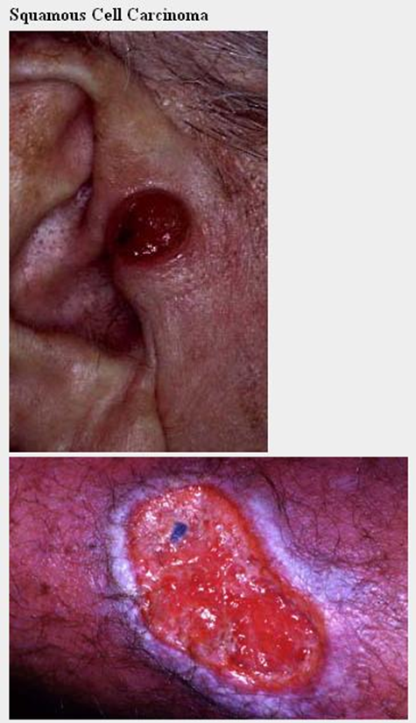
Non-melanoma Skin Cancers

Slide 64
Moles and Melanoma

Slide 65
Melanoma Warning Signs Asymmetry, Border, Color, Diameter (ABCD)

Slide 66
Damage to Eyes

Slide 67
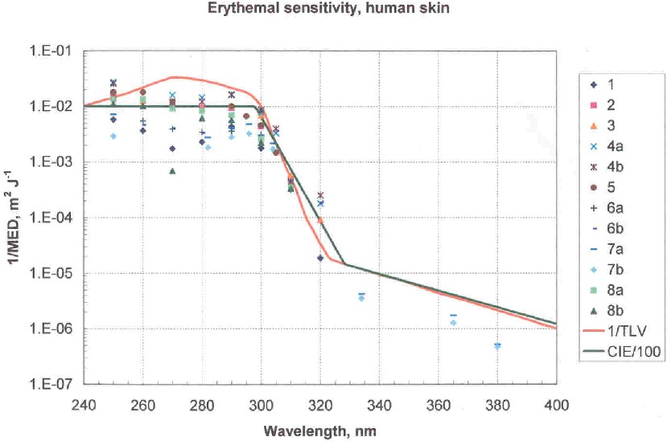
ACTION SPECTRUM DETERMINATION

Slide 68
Ocular damage action spectra (normalized at 300 nm)

Slide 69
SPECTRALLY INTEGRATED RADIATION
Radiometry
Signal (W m⁻²) = ∫_{λ} E(λ) R(λ) dλ
Biological effects
Dose rate (W m⁻²) = ∫_{λ} E(λ) B(λ) dλ
Photo-dissociation of atmospheric chemicals
Photolysis frequency (s⁻¹) = ∫_{λ} F(λ) σ(λ) φ(λ) dλ

Slide 70
Changes in surface irradiance, for 1% O₃ change
Near 300 DU
Solid: Absolute
(mW m⁻² nm⁻¹)
Dotted: Relative
(percent)
Heavy: sza = 0º
Light: sza = 70º

Slide 71
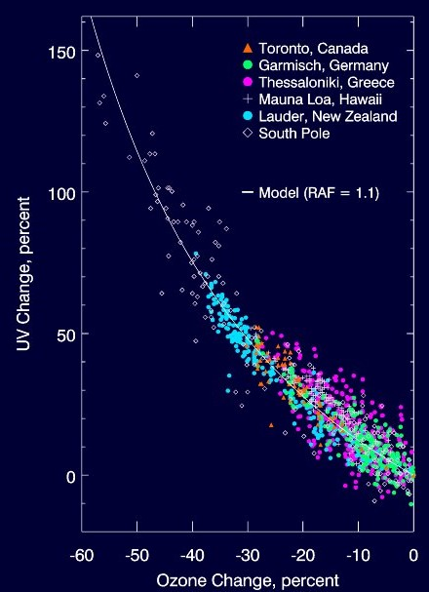
Observed dependence
of UV on O₃ changes
(clear sky)
For erythemal
(sunburning) radiation
Madronich et al. 1998

Slide 72
Global Climatology of UVR from Satellites
Total Ozone Mapping Spectrometer (TOMS):
Nimbus 7 (1 Nov 1978 – 31 Dec 1992)
Meteor 3 (22 Aug 1991 – 11 Dec 1994)
Earth Probe (2 Jul 1996 – 30 Jun 2000)
Data (Level 3/Version 7):
O₃ by UV-B wavelength pairs
Cloud reflectivity at 380 nm
1.25º lon x 1.00º lat
Model:
TUV look up tables for erythemal irradiance, as functions of sza, O₃, surface elevation
Calculate for each location, 15 min of each half day, each month, each year

Slide 73
UV_{ERY} climatology, 1979 to 2000 - Clear skies

Slide 74
UV_{ERY} climatology, 1979 to 2000 - All skies

Slide 75
UV_{ERY} change, 1980’s to 1990’s Clear sky (ozone changes only)

Slide 76
Cloud factor % changes, 1980’s to 1990’s

Slide 77
UV_{ERY} % change, 1980’s to 1990’s All sky conditions (ozone and cloud changes)

